Slide 1
SAP BTP Build Apps Training
Day 12
Anubhav Oberoy
www.AnubhavTrainings.com
Follow excellence with sheer passion

Slide 2


DISCLAIMER
The training content and delivery of this presentation is confidential, and cannot be recorded, or copied and distributed to any third party, without the written consent of Anubhav Trainings

Slide 3
Agenda – Day 12
01
Use Case
02
Create Pages for Address
03
Update Address

Slide 4

The Use case
Background:
Meet Mia is an SAP consultant working on multiple SAP S/4HANA projects. Her responsibility includes maintaining and updating business partner address data within the SAP S/4HANA system.
As part of her organization's clean core strategy, Mia wants to avoid direct customizations inside the S/4HANA system. Instead, she plans to build a side-by-side extension application using SAP Build Apps on the SAP Business Technology Platform (BTP) to manage business partner updates more efficiently and in a user-friendly manner.
Key considerations:
Mia uses SAP Build Apps, a low-code/no-code tool on BTP, to develop a standalone application that connects to the SAP S/4HANA system via public APIs available on the SAP Business Accelerator Hub.
She is not expert in coding
The application should work in user’s mobile phone
She is trying to beat the time as the requirement is quite urgent
A cloud solution is required to fulfill the requirement

Slide 5
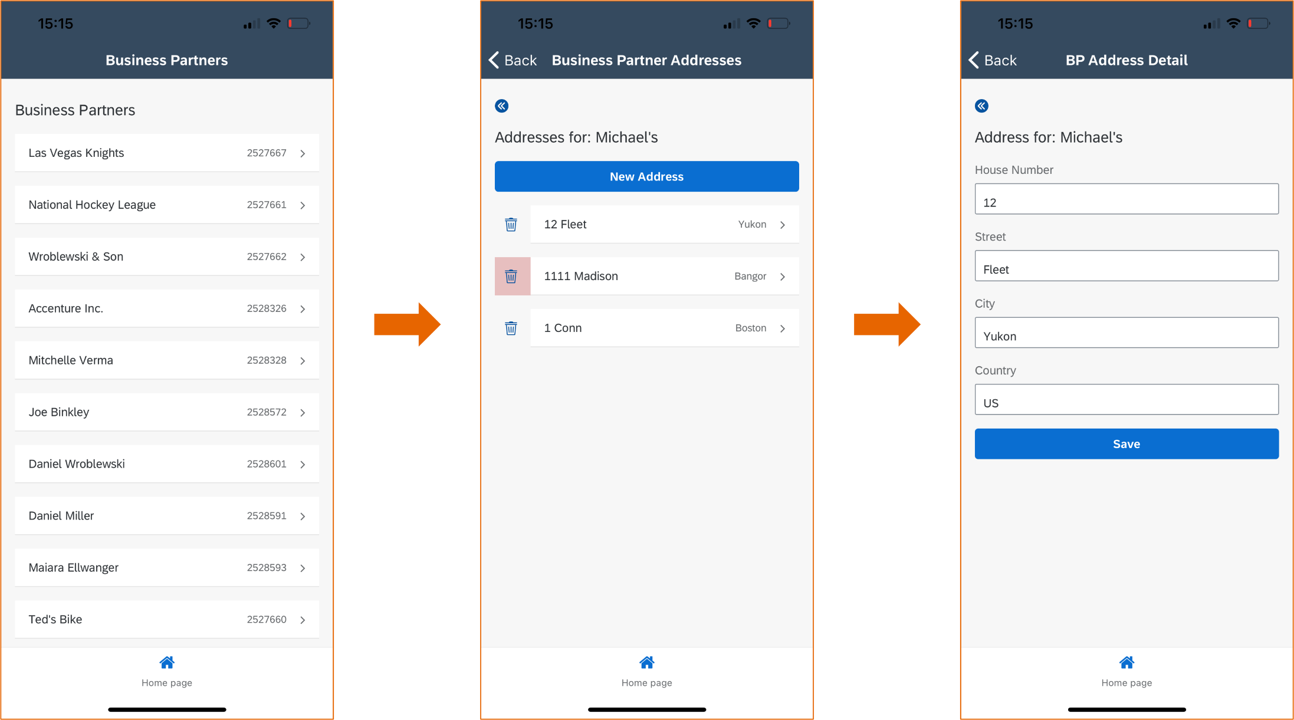
Solution Flow

Slide 6
SAP Mobile Service
SAP BTP Mobile Services is a key component of SAP Business Technology Platform (BTP) that provides tools and capabilities to build, manage, and run mobile applications securely and efficiently. It acts as a bridge between backend systems (like SAP S/4HANA, SAP BTP services, or other data sources) and mobile front-end apps, enabling developers to focus more on the user experience and business logic rather than infrastructure.
SAP BTP Mobile Services provides a mobile backend-as-a-service (mBaaS) that includes:
Connectivity to backend systems (on-premise or cloud)
Data synchronization (online/offline)
Push notifications
Mobile app lifecycle management
Security features (authentication, SSO, secure storage)
Analytics and monitoring
It supports different types of apps:
Native (iOS/Android)
Hybrid (using MDK – Mobile Development Kit)
SAP Mobile Services authenticates your mobile users with Cloud Identity Services and provides access to Integrations and SAP BTP services in your built mobile applications.

Slide 7
Usage in context of mobile service
Feature | SAP Build Apps Alone | With SAP BTP Mobile Services
App Development | ✅ | ✅
Push Notifications | ❌ | ✅ (via Mobile Services)
Offline Data Sync | ❌ (Limited) | ✅
Enterprise Auth Integration | ⚠️ (manual setup) | ✅ (pre-built options)
Backend Connectivity | ✅ | ✅ (enhanced with Mobile Services)
Monitoring & Lifecycle Mgmt | ❌ | ✅

Slide 8
Enabling SAP Mobile Service for Build Apps
Prerequisites
To be able to use SAP Mobile Services, verify that you have Subaccount entitlements of at least 1 unit for Mobile Services, resources plan.
For all SAP BTP destinations (SAP Systems) that you want to use in the built application, you need to add a MobileEnabled property with a value true to them.
Additionally, verify that the SAP-Build-Apps-Runtime destination has the MobileEnabled property as well.
Steps
Enable SAP Mobile Services
Connect Build Apps to Mobile Services

Slide 9
Dependency between MS and Build Apps
Establish a dependency between SAP Build Apps and SAP Mobile Services. Use SAP Cloud Identity Services to link your app to SAP Build Apps API, ensuring seamless integration and access to mobile services.
Navigate to your SAP Cloud Identity Services dashboard and choose the Applications & Resources tab. On the left side panel, choose the application with name {your-app-id}.TipIf you don't know your app ID, go to your project in Buildapp ID from the URL. Take the number and add the prefix buildApps, for example buildApps123
Scroll down in the newly opened tab and choose Dependencies
Choose Add to establish new dependency.
In the Add API tab enter the following details:
In the Dependency Name field, enter sap-build-apps-api.
In the Application dropdown, choose SAP Build Apps followed by your subaccount name. For example, SAP Build Apps (MySubaccount).
In API, choose SAP Build Apps backend projects.
Select Save to confirm.

Slide 10
Certification
https://www.oracle.com/in/java/technologies/javase/jdk11-archive-downloads.html
keytool -genkey -v -keystore c:\temp\anubuildsc.keystore -alias anubuildsc -keyalg RSA -keysize 2048 -validity 10000

Slide 11
Title
Content

Slide 12
Title
Content

Slide 13
Title
Content

Slide 14

What We Did
Let’s Summarize

Slide 15

www.anubhavtrainings.com
Thank You
End of Day 9

Slide 16


We’re committed to empower you to be
#FutureReady
through powerful training solutions.
We build the workforce of the future.
250+
Corporate Clients
30,000+
Learners Trained
25000+
Learners Placed
FREE WEBINARS
Sign up for free webinars with industry experts every fortnight!
Enroll Now!
Contact us today!
https://anubhavtrainings.com

